Slide 1
Digital Communication
Inter Symbol Interference
Dr. M. Venu Gopala Rao
A.M.I.E.T.E, M.Tech, Ph.D(Engg)
Cert. in R.S.T ( City & Guild’s London Institute, London)
F.I.E.T.E, L.M.I.S.T.E, I.S.O.I., S.S.I., M.I.A.E.
Professor, Dept. of ECE, K L University
mvgr03@kluniversity.in

Slide 2
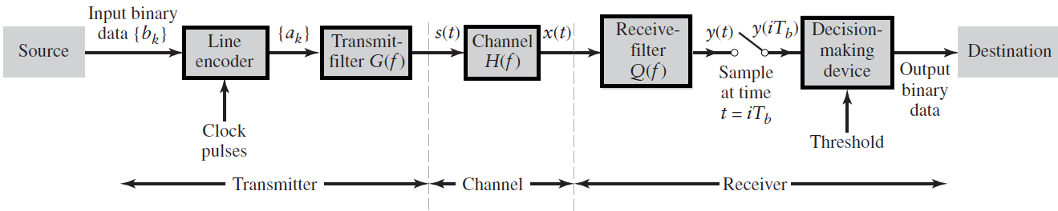
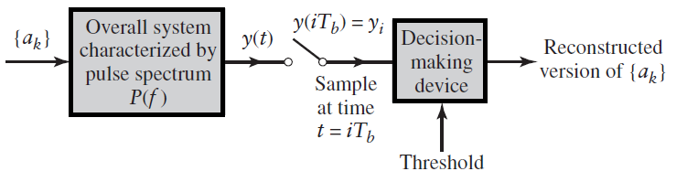
Binary Base-band data transmission System

Slide 3
The transmission of digital data over a baseband channel
Digital data have a broad spectrum with a significant low-frequency content.
Baseband transmission of digital data therefore requires the use of a low-pass channel with a bandwidth large enough to accommodate the essential frequency content of the data stream.
Typically, however, the channel is dispersive in that its frequency response deviates from that of an ideal low-pass filter.
The result of data transmission over such a channel is that each received pulse is affected somewhat by adjacent pulses, thereby giving rise to a common form of interference called inter Symbol interference (ISI).
Inter symbol interference is a major source of bit errors in the reconstrcted data stream at the receiver. To correct for it, control has to be exercised over the pulse shape in the overall system.

Slide 4
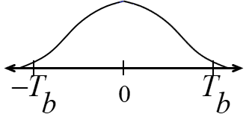
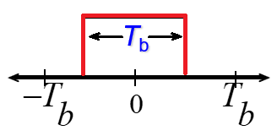
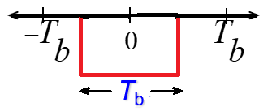
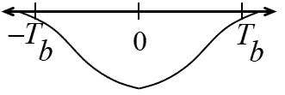
Inter Symbol Interference
Inter Symbol interference (ISI) occurs when a pulse spreads out in such a way that it interferes with adjacent pulses at the sample instant.
Example: assume polar NRZ line code. The channel outputs are shown as spreaded (width T_{b} becomes 2T_{b}) pulses shown (Spreading due to bandlimited channel characteristics).
Channel Output
Pulse width T_{b}
Channel Input Pulse width T_{b}
Data 1
Data 0

Slide 5
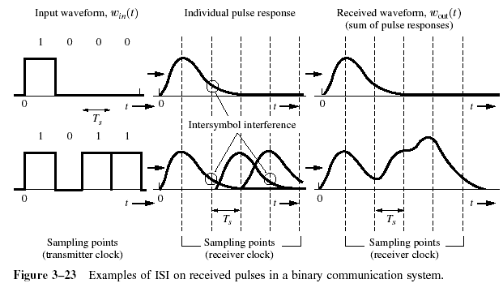
ISI
If the rectangular multilevel pulses are filtered improperly as they pass through a communications system, they will spread in time, and the pulse for each symbol may be smeared into adjacent time slots and cause Intersymbol Interference.
How can we restrict BW and at the same time not introduce ISI? 3 Techniques.

Slide 6
Intersymbol Interference
For the input data stream:
The channel output is the superposition of each bit’s output:
1
0
1
1
0
1
Resultant Channel Output Waveform
1
0
1
1
0
1

Slide 7
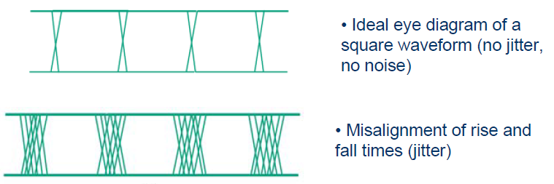
EYE Diagram that reflect ISI

Slide 8
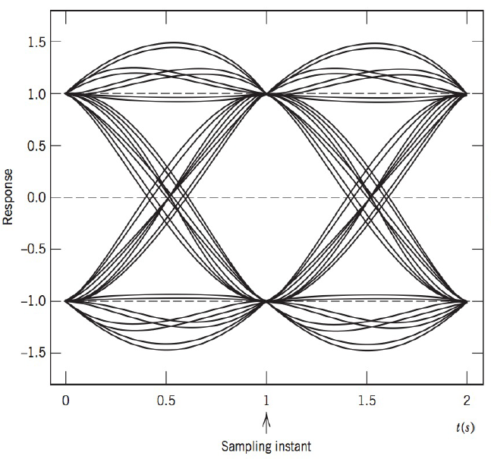
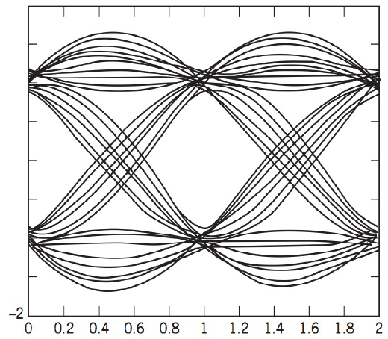
Eye diagram of received signal with no bandwidth limitation.
Eye diagram of received signal using a bandwidth-limited channel response

Slide 9
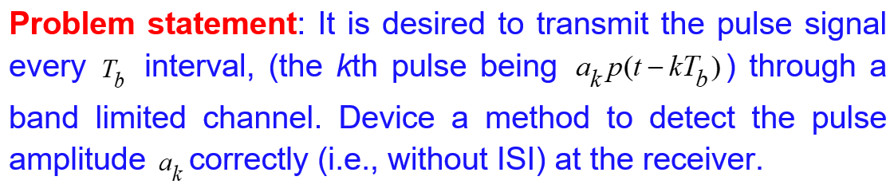
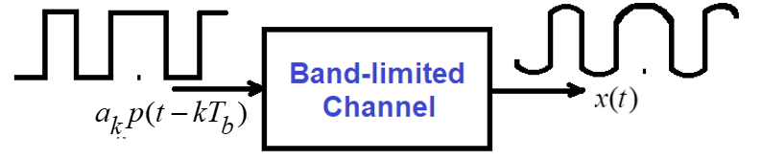
Inter Symbol Interference
Inter Symbol Interference (ISI) is caused by nonideal channels that are distorted over the entire input signal bandwidth. ISI, as a manifestation of channel distortion, can cause errors in pulse detection if it is large enough.

Slide 10
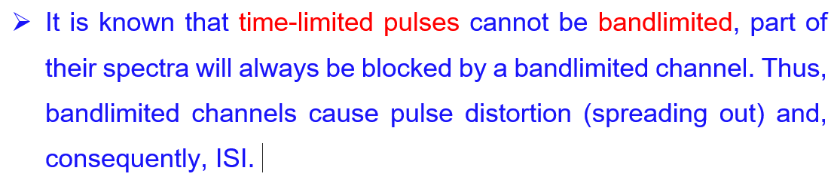
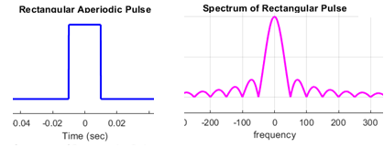

Slide 11
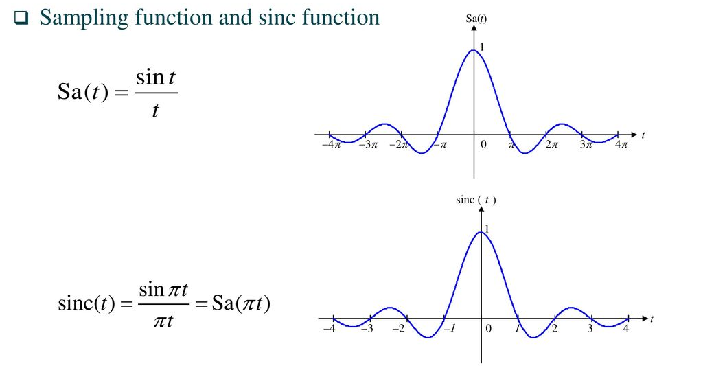

Slide 12
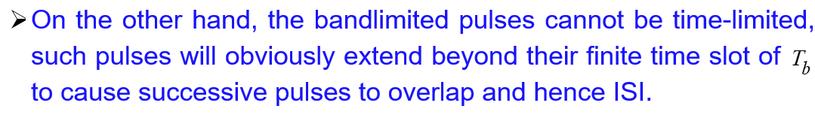
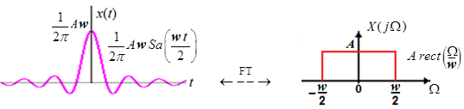
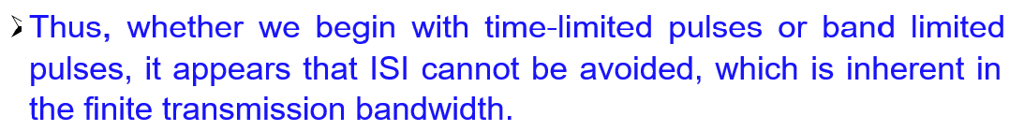

Slide 13
ISI elimination techniques
It is important to note that pulse amplitudes can be detected correctly despite pulse spreading (or overlapping), if there is no ISI at the decision-making instants.
This can be accomplished by a properly shaped band limited pulse signals.
To eliminate the effect of ISI, Nyquist proposed the following criteria for pulse shaping.
Ideal Nyquist Criterion: Sinc Pulse.
Practical filter: Raised Cosine Filter

Slide 14
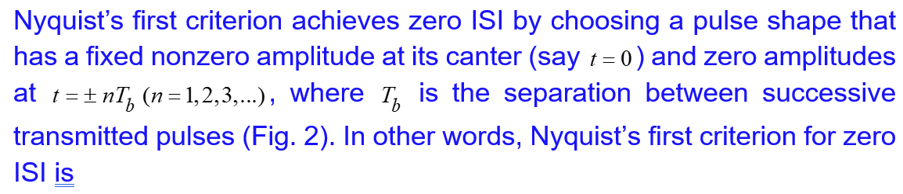

Ideal / Nyquist’s (First) Criterion for Zero ISI:

Slide 15
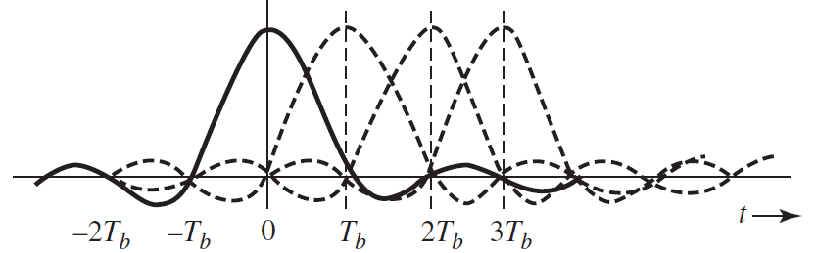
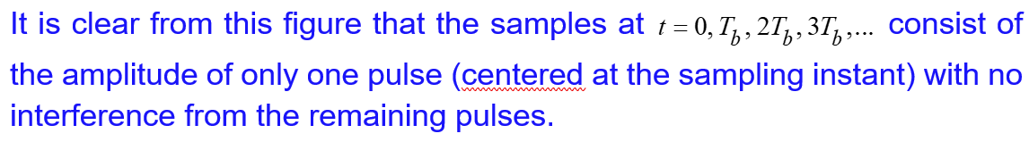
Ideal / Nyquist’s (First) Criterion for Zero ISI:

Slide 16
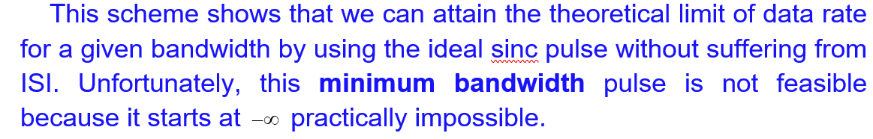
Ideal / Nyquist’s (First) Criterion for Zero ISI:

Slide 17
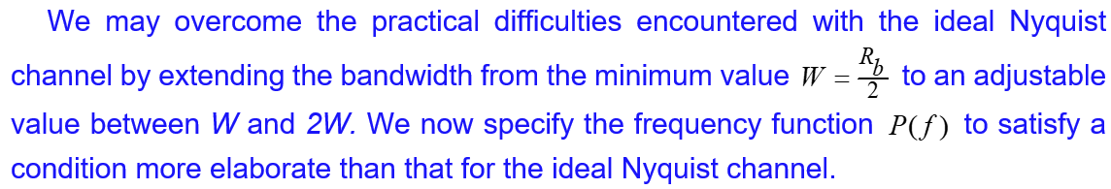
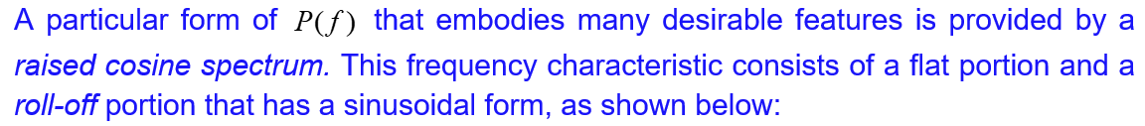
2. Practical / Raised Cosine Filtering Criterion for Zero ISI

Slide 18
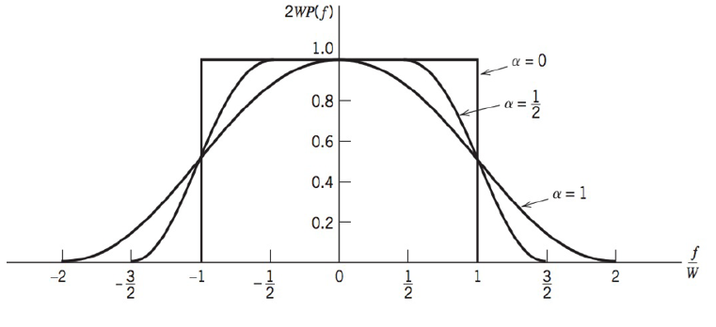
Raised Cosine Pulse
Alpha is called roll off factor

Slide 19
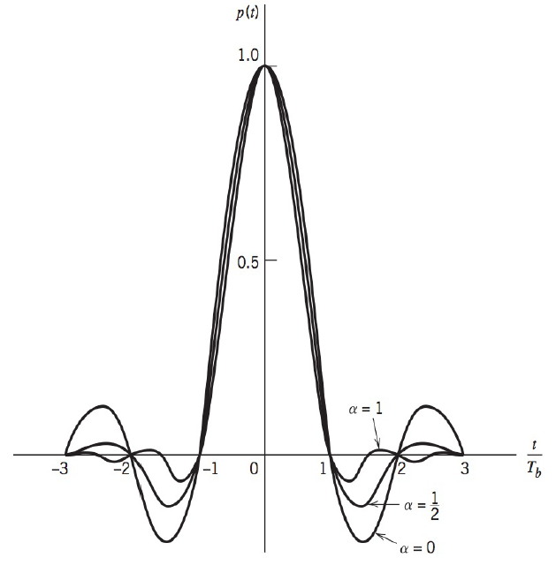

Raised Cosine Pulse
The time domain expression and plot for Raised cosine filter are illustrated below:

Slide 20
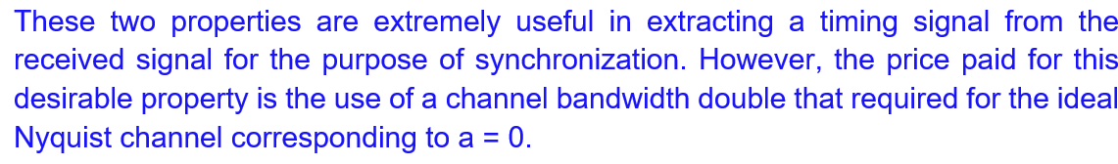
Properties of Raised Cosine Pulse

Slide 21
End

